Slide 1


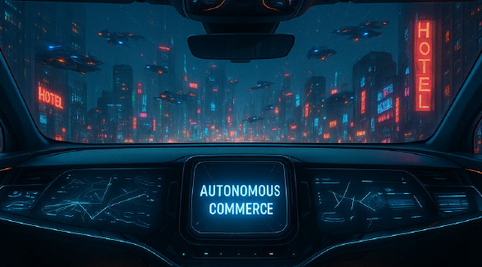


>tage retten…

Slide 2
WORKSHOP QUALITY TO GO - ENGINEERED IN SWITZERLAND

Slide 3

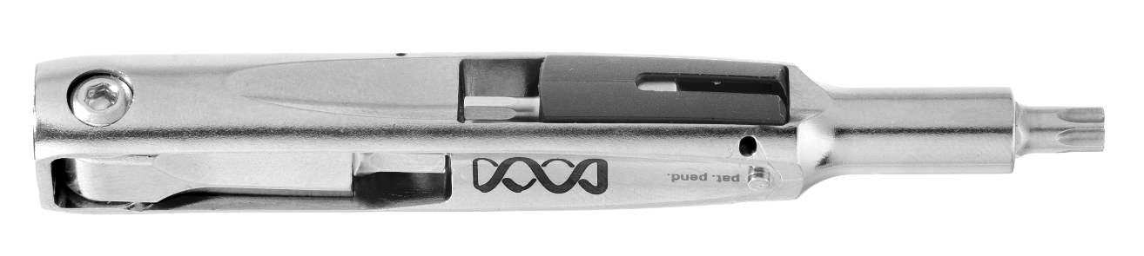

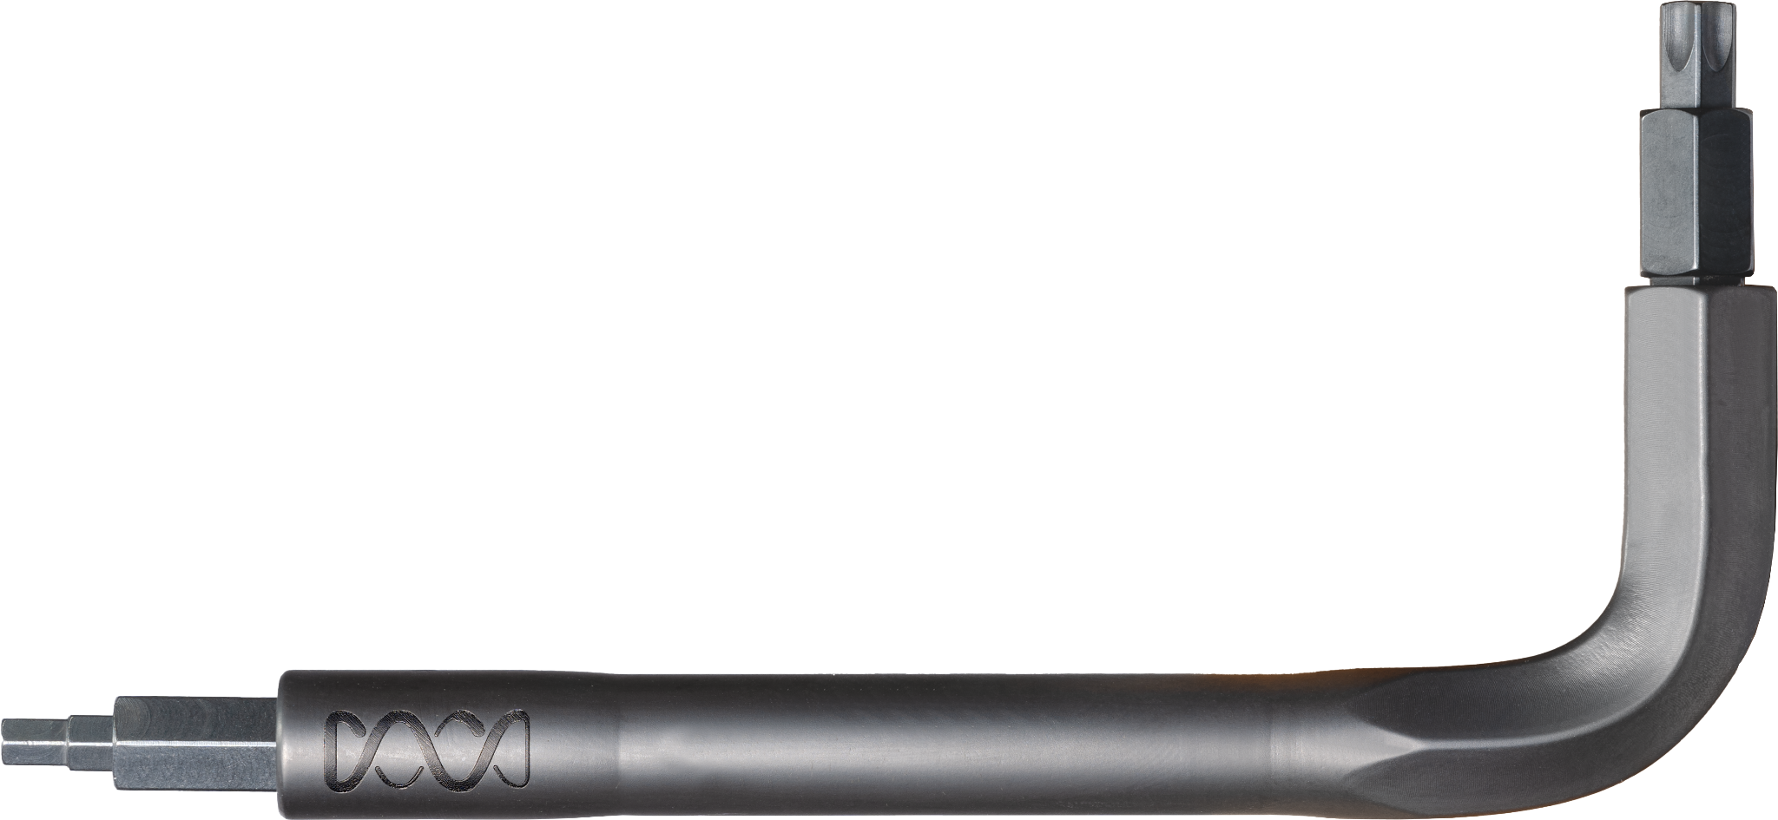
LIGHTWEIGHT
MINIMAL
$
VERSATILE
CUSTOMIZABLE
$$

Slide 4



CARRYING OPTIONS

Slide 5



Slide 6
Emporix Commerce

Slide 7
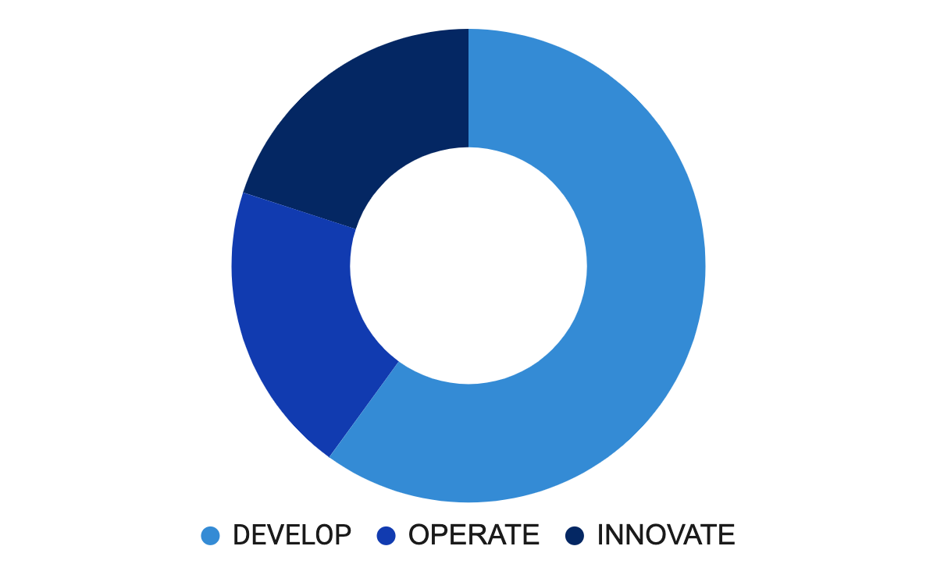
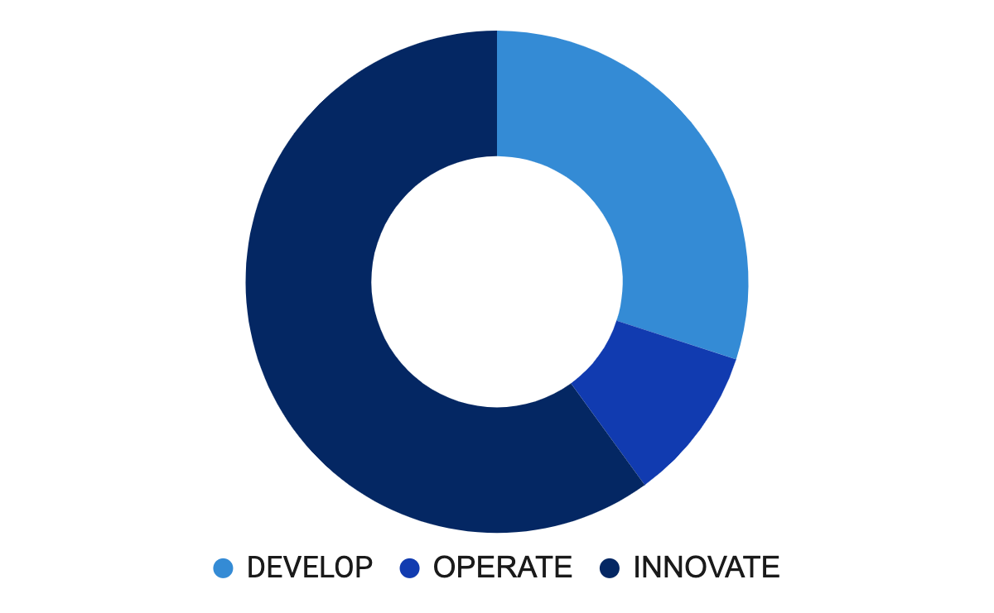
WENIGER BAUEN, um SCHLANK ZU AGIEREN und SCHNELL ZU REAGIEREN
Der Alte Weg
Der Neue Weg
Low
AGILITY
Low
EFFICIENCY
Low
SPEED
High
AGILITY
High
EFFICIENCY
High
SPEED
Notes:
What does this new reality mean for us as solution providers and when I speak about us, I speak about you as implementation partners as much about us as a SaaS vendor. It means that we need to aim for leaner and meaner implementations. We need to aim for 3-6 months instead of 1-2 years implementation time. We need to provide pre-built solutions and integrations. But we need also to avoid programming and enable configuration when adjustments are needed in order to Run Lean. While we invest less time building and running, we can spend more time advising and innovating.

Slide 8
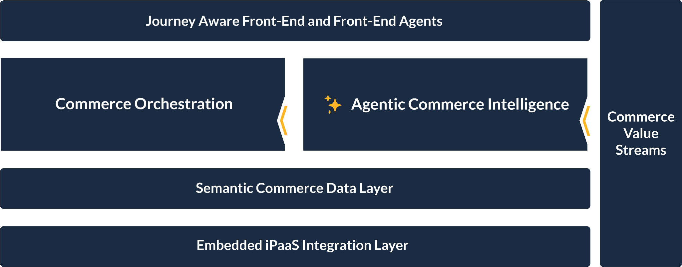
B2B Autonomous Commerce Execution
Emporix ACE Platform

Slide 9
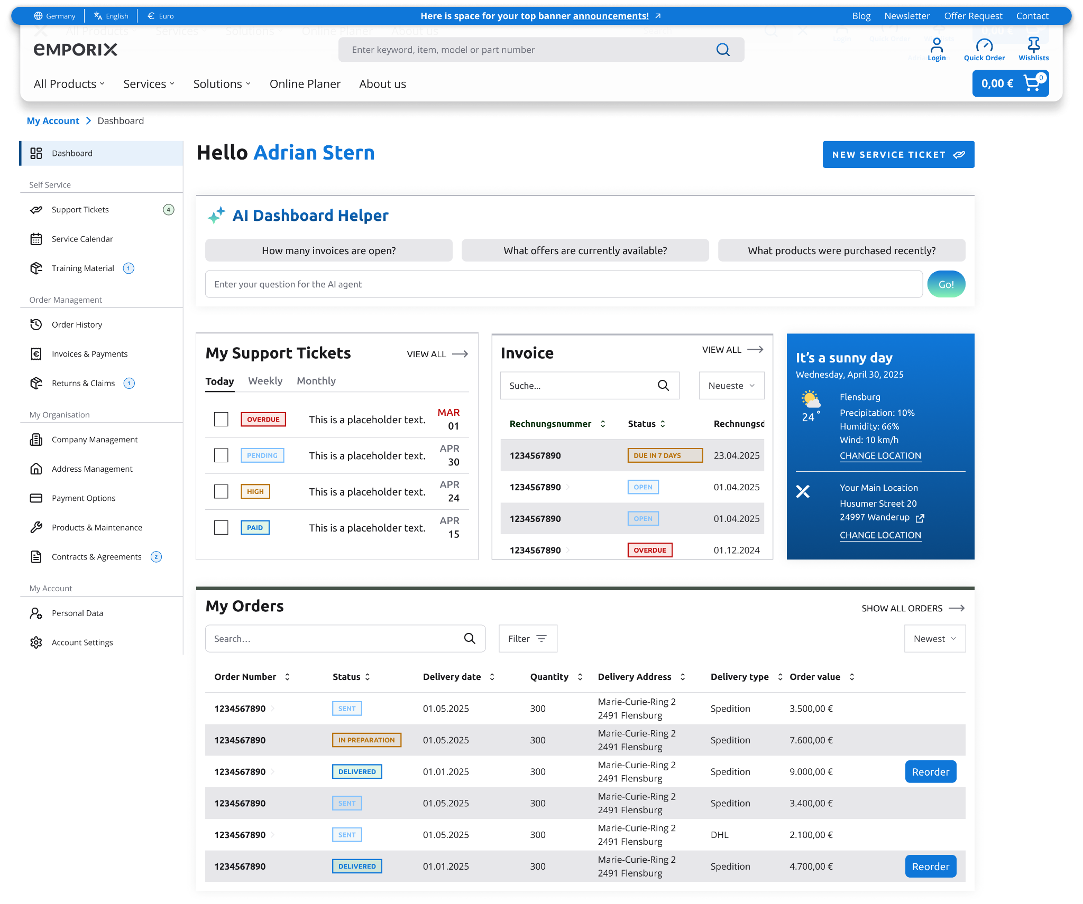
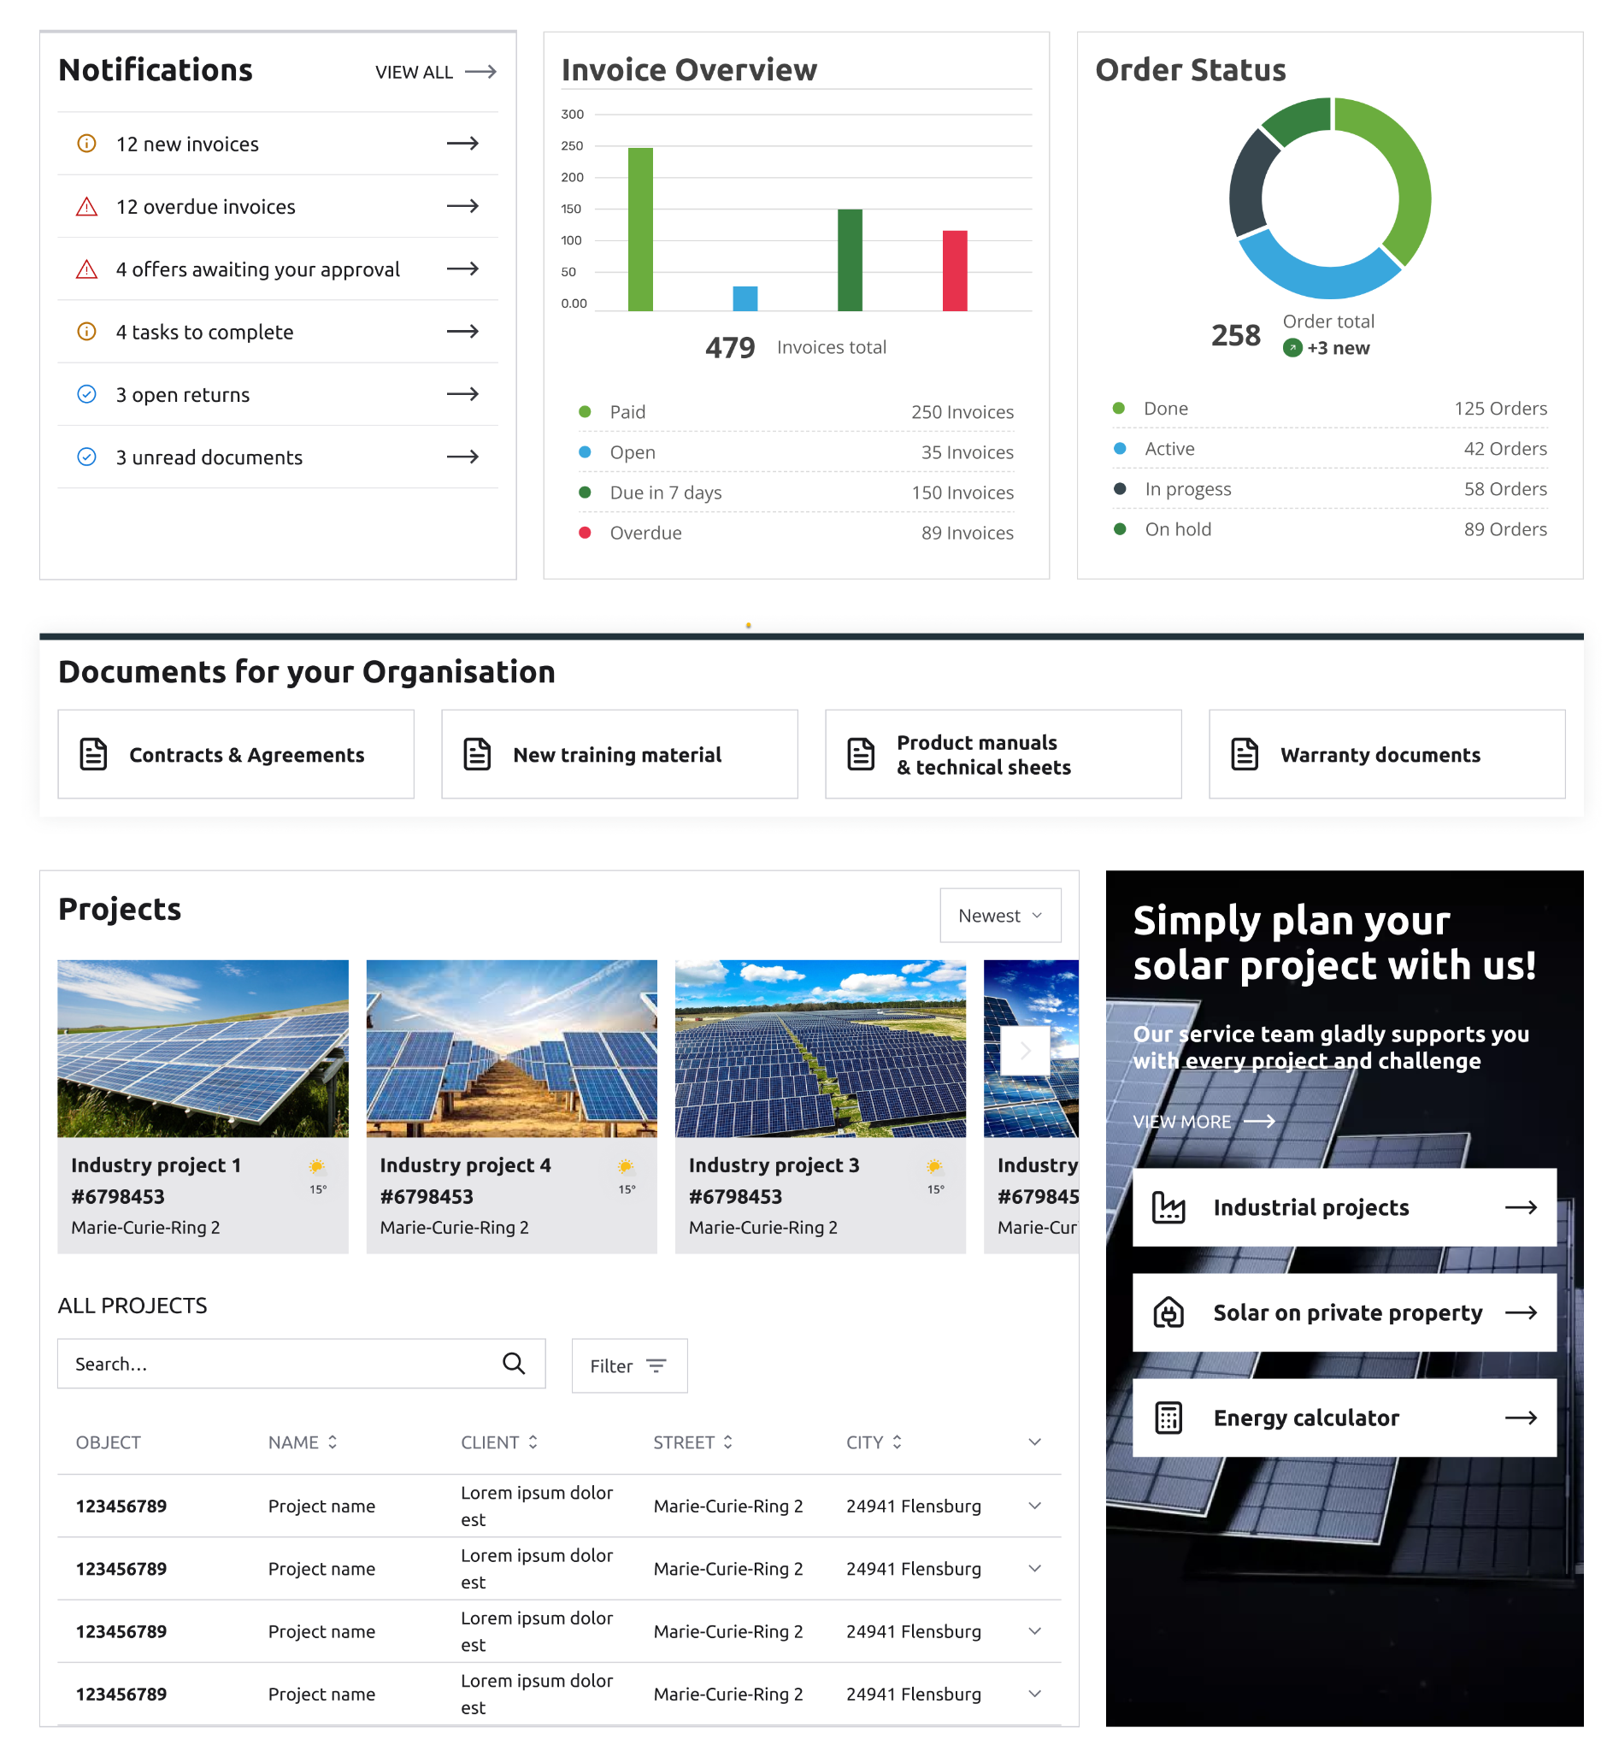
Orchestrated Storefront – Self-Service-Portal Beispiel

Slide 10
B2B Autonomous Commerce Execution
Emporix ACE Platform

Slide 11

Emporix Commerce Funktionen / APIs
Configuration
Settings
Sites
Tax
Currency
Unit handling
Country
Mixins
Custom Entity
Checkout
Cart
Checkout
Payment Gateway
Fee
Quote
Shopping list
Customer
Customer
Addresses
Segment
Group
Company & Subsidiaries
Approval
Product
Product
Product Templates
Catalog
Category
Label
Brand
Supplier
Order & Fulfillment
Order
Availability
Pick-Pack
Shared Order
Return
Invoice
Credit Check
Order2Cash
Rewards & Promotions
Coupon/Voucher
Reward Points
Segment
Delivery & Shipping
Delivery Orders
Delivery Plan
Shipping Cost
Shipping Method
Shipping Zone, Group and Time
Tracking
User
MD User
Group
Role & Permission
Access
Session Context
IAM
Price
Price Models
Price Lists
Price Matching
Sale price
AI Agent
Onboarding
Data Import
Content and Translation
Storefront
Communication
Email
Newsletter
Search
Indexing
Integration
Webhooks
Extensions
Sepa Export
Connector
Media
Assets
Utility
Sequential ID
External Prices
External Products
Emporix Domains

Slide 12
B2B Autonomous Commerce Execution
Emporix ACE Platform

Slide 13

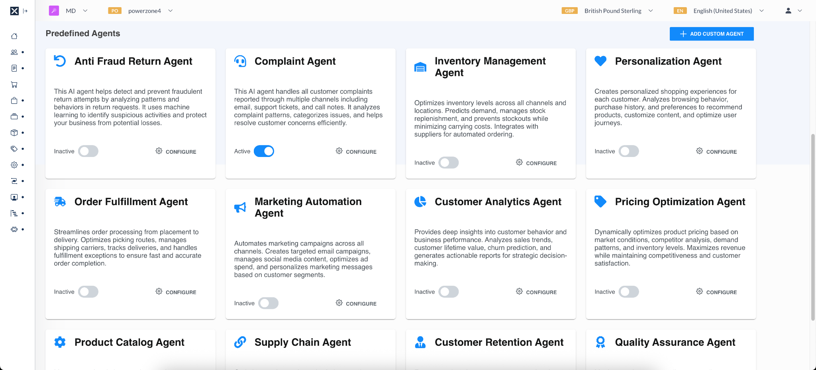
KI-Agenten Library

Slide 14
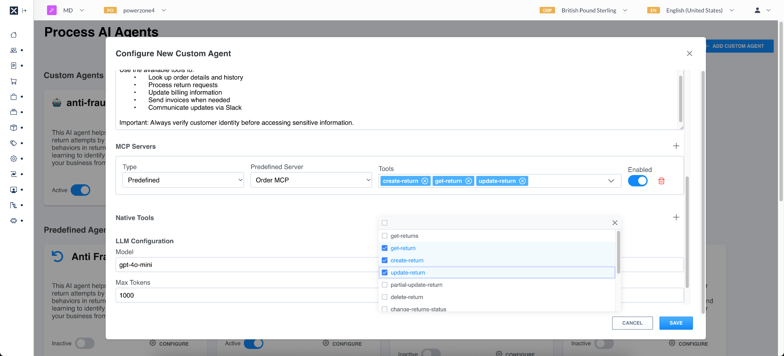
KI-Agenten Builder

Slide 15
B2B Autonomous Commerce Execution
Emporix ACE Platform

Slide 16
Jump-Start mit Vorgefertigten Value Streams
Customer Journey
Marketing
Catalog
Product
Inventory
Promotion
Orders &
Fulfillment
Payment &
Settlement
Service
Returns
Commerce Value Streams
Overstock Campaign
Dynamic Category
New Product Introduction
Product Substitution
First Registration Promotion
Order Splitting
Exception Handling
Ticketing
Self Service Return
Customer Segmentation
Guided Selling
Media Visibility Check
Automated Re-Ordering
Stockout Promotion
PDF Purchase Orders
Credit Score Check
AI-driven Q&A Responder
Return Restock
Abandoned Cart
Search Updates
Dynamic Pricing
Smart Restocking
Dynamic Pricing
Inventory Routing
Order Export
Field Service Orchestration
Return Fraud AI-Analysis
Customer Onboarding
Content Updates
Price List Updates
Automated Spot Buy
Slow-Moving Items
Recurring Orders
Subscriptions
Escalation
Return Authorisation
Notes:
What you really want are Value Streams sitting on top of those APIs. Providing a MAP, a GPS and a Navigation System. Value Streams are pre-built components that orchestrate customers, employees and data throughout the customer journey. From Marketing until Service every step in the customer journey comes with pre-built value streams. While they are pre-built, they can easily be adjusted via a visual interface.

Slide 17
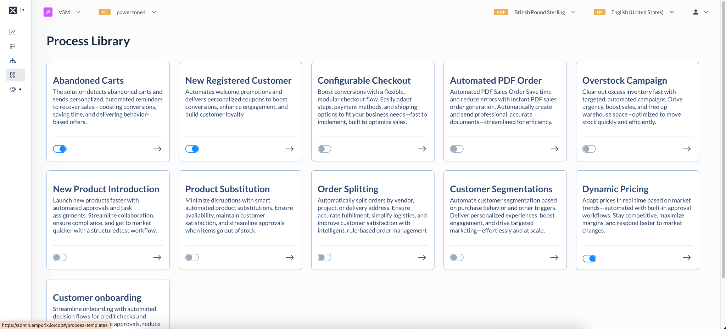
Value Stream Library

Slide 18
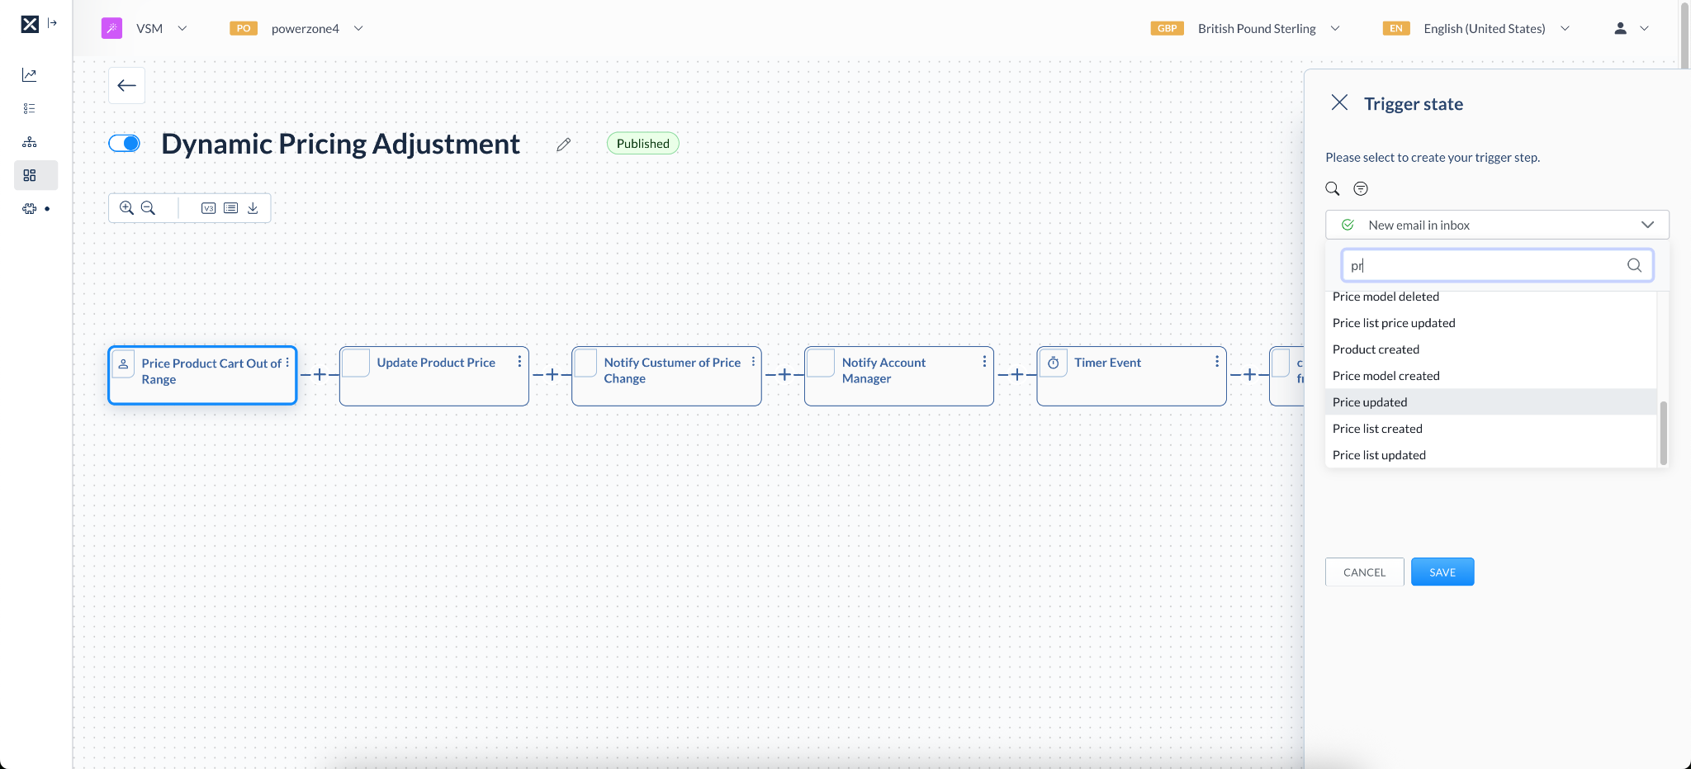
Value Stream Modeller

Slide 19
B2B Autonomous Commerce Execution
Emporix ACE Platform

Slide 20
>digital commerce Pioniere sit 1997…

Slide 21

Über Agile Networks
Wir sind ein Digital Experience Unternehmen mit umfangreicher Expertise darin, modulare Kunden Erfahrungen entlang Ihrer Wertströme zu schaffen. Wir integrieren zentrale Systeme in eine agile, skalierbare Infrastruktur.
Unser durchdacht gestaltetes Portfolio ist darauf ausgerichtet, Ihr Unternehmen zu stärken und wirkungsvolle, modular aufgebaute Kundenerlebnisse zu ermöglichen.
Unser Ansatz:
GUETER RAT
IMPLEMENTIERUNG
INTEGRATION
MODULAR ZUSAMMENSETZBARE WERTSCHÖPFUNGSSTRÖME

Slide 22
>wir bauen einen agenten…

Slide 23

>merci villmal…
Michael Ryffel
michael.ryffel@agilenetworks.ch
www.linkedin.com/in/michael-ryffel

Slide 24


SAP Integration & Emporix
ERP
SAP Integration Suite
ERP
EMPORIX
MATMAS
Replicate Material from ERP to Emporix
Products API
COND_A
Replicate Prices and Discounts from ERP to Emporix
Price API
DEBMAS
Replicate B2B Customer from ERP to Emporix
ADRMAS
Customer Mgt API
ADR2MAS
Customer API
ADR3MAS
CREATE ORDER FROM DAT
Replicate Order from Emporix-to-SAP ERP
Order Webhook
SAP- Integrationsdokumentation und -Videos: https://developer.emporix.io/ce/extensibility-and-integrations/integrations/sap-integration

Slide 25
Resources
Emporix Free Trial: https://www.emporix.com/emporix-free-trial
Emporix Management Dashboard (MD): https://dashboard.emporix.io/
Emporix Development Portal (API Keys, User Access, …): https://app.emporix.io/
Emporix Storefront Code: https://community.emporix.io/t/emporix-frontend-release-information-and-dates/200
Emporix Commerce Engine Documentation: https://developer.emporix.io/ce
Emporix API Documentation: https://developer.emporix.io/api-references
Emporix API References: https://developer.emporix.io/api-references-1
Emporix Postman Collection: https://www.postman.com/emporix/emporix-commerce-orchestration-platform/overview
Emporix Orchestration Engine: https://developer.emporix.io/oe
Emporix Orchestration Engine - Hello World tutorial: https://developer.emporix.io/oe-user-guides/getting-started/trails/setting-up-a-first-digital-process/
Emporix AI-MCP Servers: https://developer.emporix.io/ce/extensibility-and-integrations/ai-intro/mcp
Emporix Community: https://community.emporix.io/

